Slide 1
Introduction to deep learning
Sungjoon Choi
(sungjoon.choi@cpslab.snu.ac.kr)

Slide 2

Deep learning
Wikipedia says:
“Deep learning is a branch of machine learning based on a set of algorithms that attempt to model high-level abstractions in data by using multiple processing layers, with complex structures or otherwise, composed of multiple non-linear transformations.”
High-level
abstraction
Machine
Learning
Network

Slide 3
Deep learning
Artificial Intelligence
Machine Learning
Deep learning
MLP
CNN
RNN

Slide 4
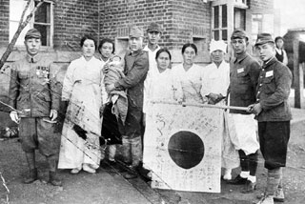
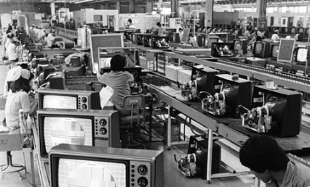
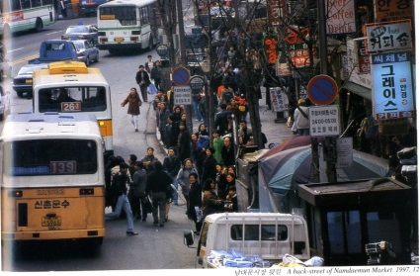
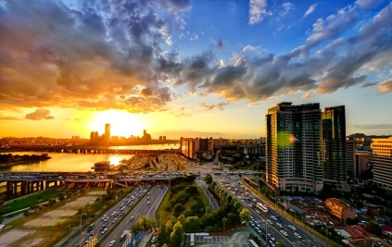
Is it brand new?
Neural Nets
McCulloch & Pitt 1943
Perception
Rosenblatt 1958
RNN
Grossberg 1973
CNN
Fukushima 1979
RBM
Hinton 1999
DBN
Hinton 2006
D-AE
Vincent 2008
AlexNet
Alex 2012
GoogLeNet
Szegedy 2015

Slide 5
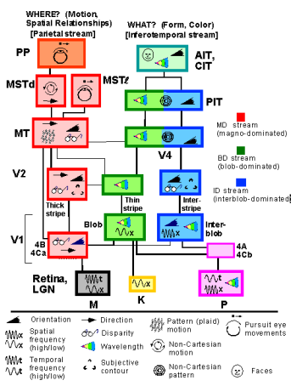
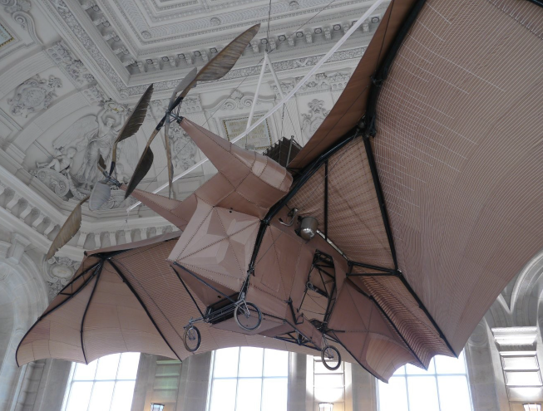
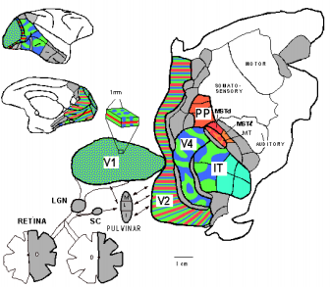
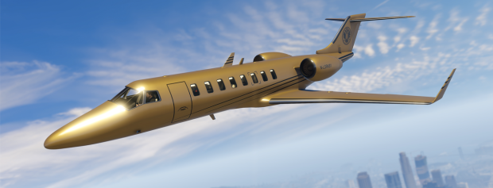
Inspired by nature?
L'Avion III de Clement Ader, 1897
Sure there is some resemblance!
But, do not go TOO FAR.
Slide credit: Yann LeCun

Slide 6
Deep architectures
Feed-Forward: multilayer neural nets, convolutional nets
Feed-Back: Stacked Sparse Coding, Deconvolutional Nets
Bi-Directional: Deep Boltzmann Machines, Stacked Auto-Encoders
Recurrent: Recurrent Nets, Long-Short Term Memory

Slide 7
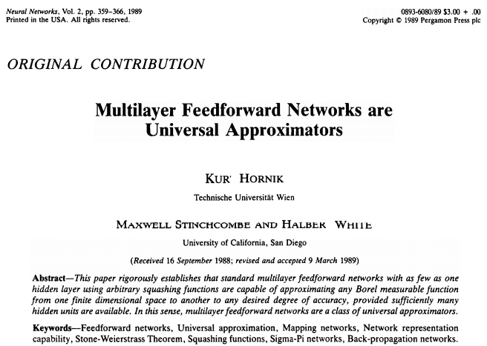
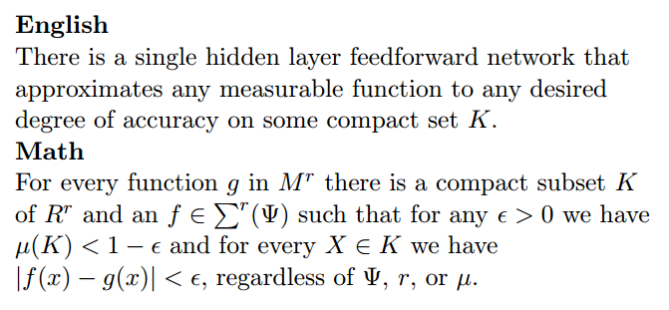
Theory
Cited > 12,000

Slide 8
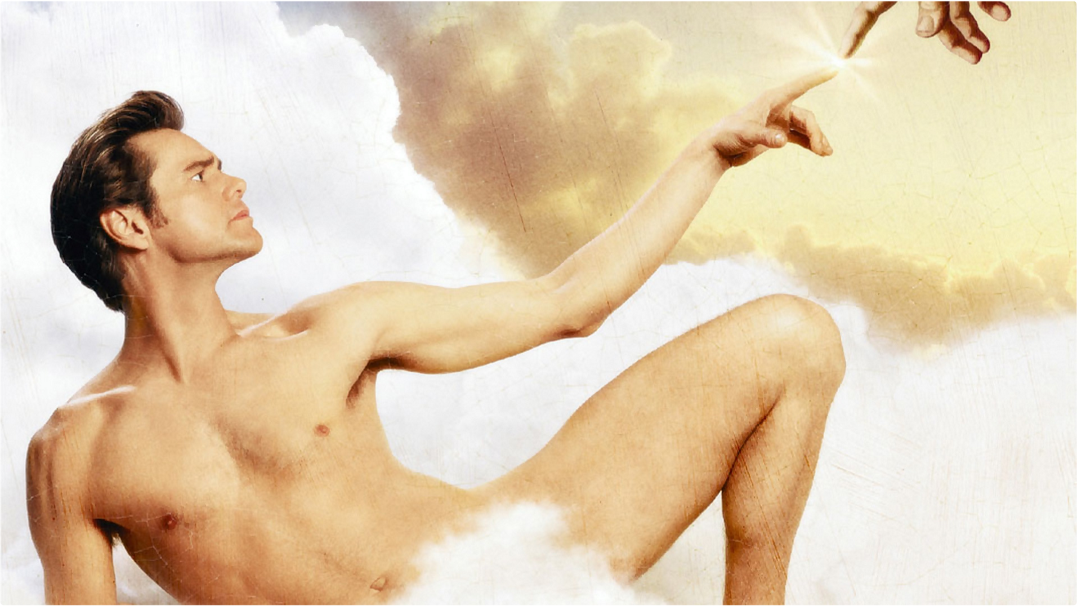
Is is omnipotent?

Slide 9
Development tools

Slide 10
Deep learning tools?
MatConvNet
Theano
TensorFlow
Torch
Caffe

Slide 11
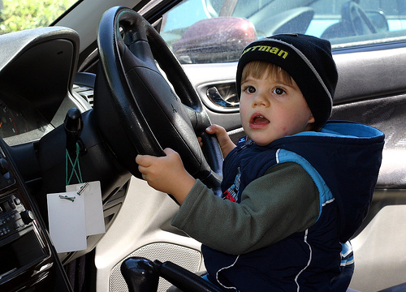
To tell the truth

Slide 12
Caffe
From U.C. Berkeley
Written in C++
Good for training or fine-tuning feedforward models

Slide 13
Caffe
Blobs: Store data and derivatives
Layer: Transform bottom blobs and top blobs
Net: Many layers; computes gradient via forward / backward
Solver: Uses gradients to update weights
Data (Layer)
W
InnerProduct (Layer)
SoftMax (Layer)
F
X
Y

Slide 14
Caffe
(+) Good for feedforward networks (CNN)
(+) Good for fine-tuning existing networks
(+) Train models without writing any code
(+) Python interface is pretty useful
(-) Need to write C++ / CUDA for new GPU layers
(-) Not good for recurrent networks
(-) Cumbersome for big networks (GoogLeNet, ResNet)

Slide 15
Torch
From NYU
Written in C and Lua
Used a lot in Facebook and DeepMind

Slide 16
Torch
(+) Easy to write your own layer types and run on GPU
(+) Many available library codes and packages
(+) Lots of pretrained models
(+) Lots of modular pieces that you can combine
(-) Lua
(-) Less plug-and-play than Caffe
(-) Not great for RNNs

Slide 17
Theano
From University of Montreal
Embracing computation graphs, symbolic computation
High-level wrappers: Keras, Lasagne

Slide 18
Theano
(+) Python + numpy
(+) Computational graph is cool
(+) Good for RNNs
(+) High level wrappers ease the pain
(-) Not enough pretrained models
(-) Error messages can be unhelpful
(-) Raw Theano is somewhat low-level

Slide 19
TensorFlow
From Google
Very similar to Theano
Easy visualizations
Multi-GPU and multi-node training

Slide 20
TensorFlow
(+) Python + numpy
(+) Computational graph is cool
(+) Much faster than Theano
(+) Easy to modify nets
(-) Not many pretrained model (but it will get better)
(-) Training time is slower than others right now
(-) Can hack into the networks

Slide 21
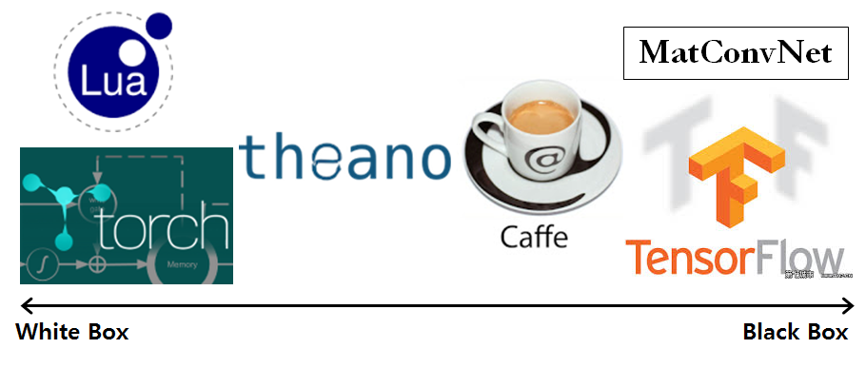
White to black

Slide 22
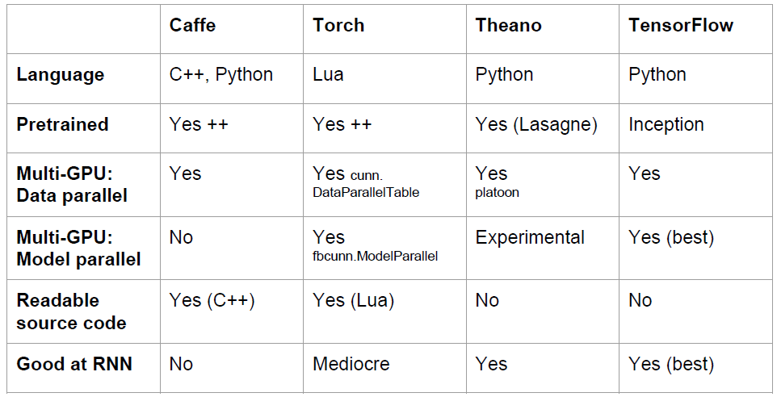
Overview

